Slide 1
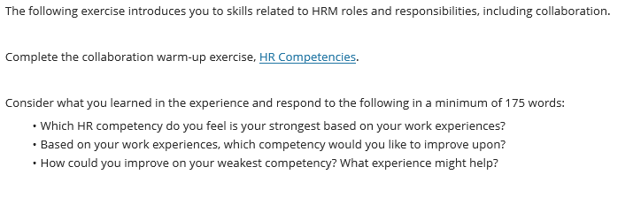
Class Discussion 175 Words based upon these slides and answer the slide 12. Reference is not part of 175 words.

Slide 2


Slide 3


Slide 4


Slide 5


Slide 6
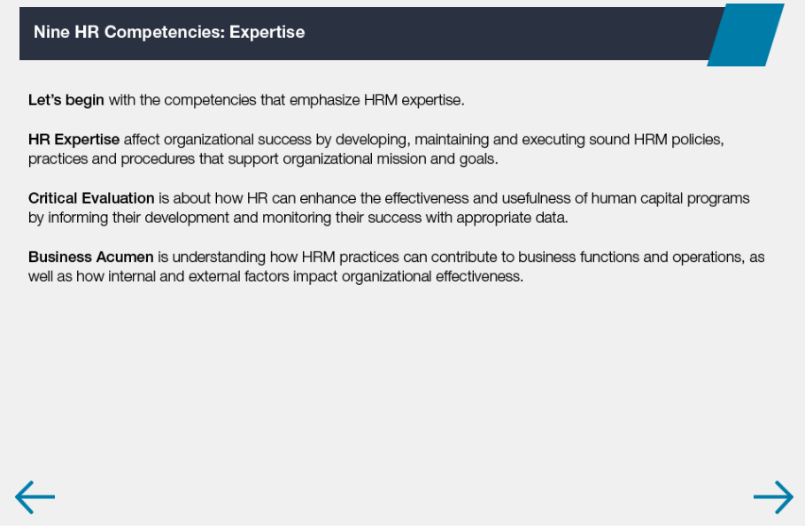

Slide 7
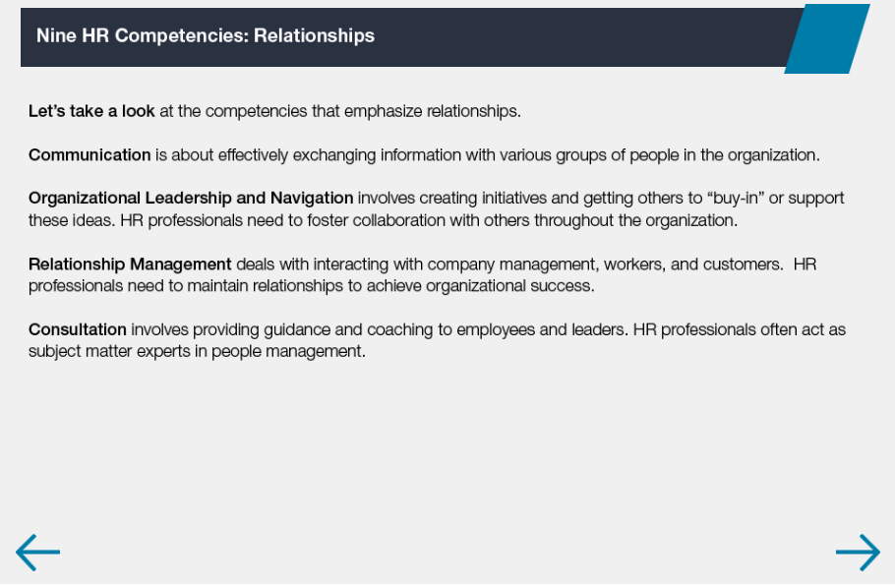

Slide 8


Slide 9


Slide 10
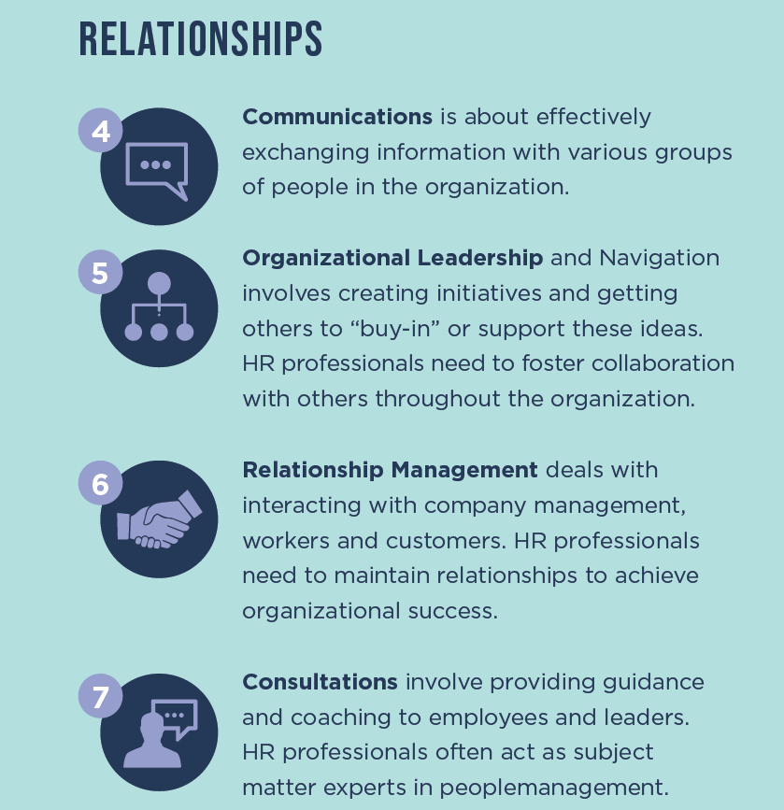

Slide 11


Slide 12
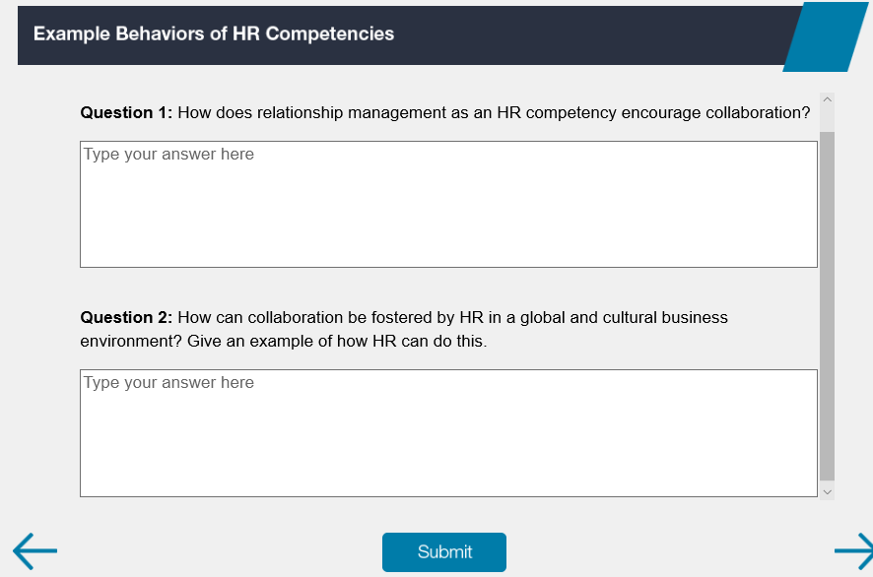

Slide 13
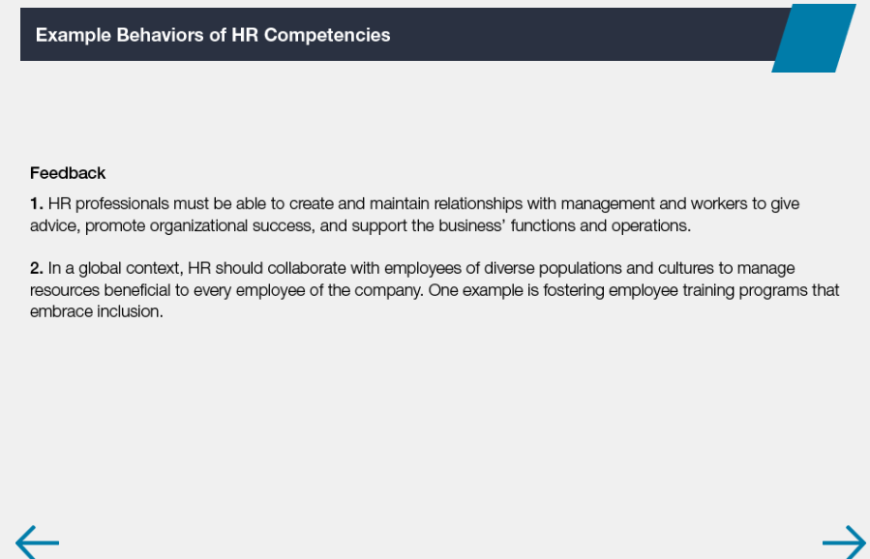

Slide 14


